Slide 1


Web assistant

Slide 2
Look of web assistant
This figure will appear after 5 seconds after scrolling on page to help you
Web assistant will be in the lower right corner

Slide 3

Smaller look of web assistant
if you do not click on logo to 5 seconds web assistant will disappears and smaller logo will appears in the lower right part of page
0
Two possible looks

Slide 4
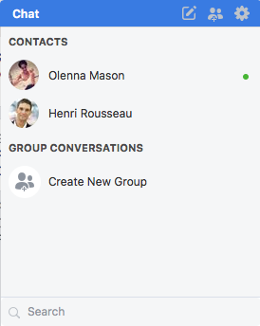
Helping window of assistant
This window will appear when you click on logo of web assistant
It will look like chat window on Facebook
Here will be prepared some most common tasks with help
If there will be more questions down will be text “All questions here”. So if you click on them on new window will appears new page with more questions and how to solve them or find questions
Help assistant
Where can I find…?
more↓
What to do if…?
more↓
What is…?
more↓
How to earn money from Steem?
more↓
All questions here

Slide 5
List of possible questions
1) What is ... ?
a. -Blockchain
b. -Mvest
c. -Steem
d. -Steem Dollars
e. -Steemit platform
f. -Steem witnesses
g. -Steem power
i. -powering up
ii. -powering down
2) -Why is steems price going down?
3) -Why there is 2 currencies?
4) -What counts more commenting/upvoting/resteeming?
5) -Do I profit from resteeming someones elses post?
6) -Is there any other way to earn steem?
7) -How long will I be getting paid for one post? (7days)
8) -What is benefit of holding Steem power?
9) -Should I buy steems and convert them to Steempower or buy Steem dollars and
convert them?
10)-Should I start blogging?
11)-Usage of Steem dollars
12)-How to vote for Steem witnesses?
13)-Exchange rate of steem dollars
14)-Can I mine Steem?
15)-Where can I find Info for official launch of blockchain
16)-Any way to see a raw data?
17)-How often blockchain produce new block?
18)-Differences between Proof of (work/stake/delegated stake)
19)-How is Steem different from a Bitcoin?
20)-How bandwidth work?
21)-Github page for Steem blockchain?
22)-Is it open-source?
23)-From where are coming these Steem dollars?
24)-Long of transaction?
25)-Are there any fees on transaction ?
26)-Are there any fees on providing Steem?
27)-How can I withdraw Steem or Steem dollars?
28)-Can I sell goods or services on Steem?
29)-What can I do with Steem Dollars?
30)-Steem whitepaper and its purpose
31)-investing in steem
32)-hacked account
33)-hacked transaction
34)-security overall
35)-lost password
36)-how to keep my account secure?
37)-keys?
a. -posting key
b. -active key
c. -memo key
d. -owner key
38)-What are developers intented to do?

Slide 6
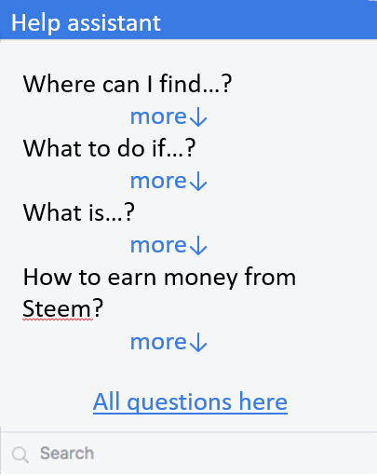
Search window
In search window you can write the key word that will search for them on web page and show you all results for that search word.
It can appears on new page only in small “Help assistant“ window or on new page

